Slide 1
Digital Portfolio
STUDENT NAME : S.Rakshan
REGISTER NO AND NMID : 222402515/asnum161222402515
DEPARTMENT : BSc.Computer science
COLLEGE: COLLEGE/ UNIVERSITY : Prince Shri Venkateswara Arts
And Science College/Madras University

Slide 2
PROJECT TITLE :
Digital Portfolio

Slide 3


AGENDA
Problem Statement
Project Overview
End Users
Tools and Technologies
Portfolio design and Layout
Features and Functionality
Results and Screenshots
Conclusion
Github Link
3/21/2024 Annual Review

Slide 4

PROBLEM STATEMENT
Resumes and profiles often feel static and fail to show creativity or real skills. A digital portfolio provides an engaging way to present projects, talents, and achievements more effectively..

Slide 5

PROJECT OVERVIEW
This digital portfolio is designed to showcase my skills, projects, and achievements in a modern and interactive way. It contains containers for my skills,about me and contact information. The goal is to create a single platform where employers, clients, and collaborators can easily explore my work and understand my capabilities.

Slide 6

WHO ARE THE END USERS?
Potential Employers/Recruiters – to evaluate skills, projects, and experience.
Clients/Collaborators – to explore work samples before partnerships.
Peers/Community – for networking, learning, and inspiration.

Slide 7

TOOLS AND TECHNIQUES
Vs code - Code Editor
HTML – Structure purpose
CSS – Styling purpose

Slide 8
POTFOLIO DESIGN AND LAYOUT
Layouts Included:
Home
About Me
Skiils
Contact info

Slide 9
FEATURES AND FUNCTIONALITY
Contains Navigation Bar
Has Smooth Scrolling feature
Pop up animations for containers and buttons
Glowing effect for conatiners and button
Has a Form validation

Slide 10
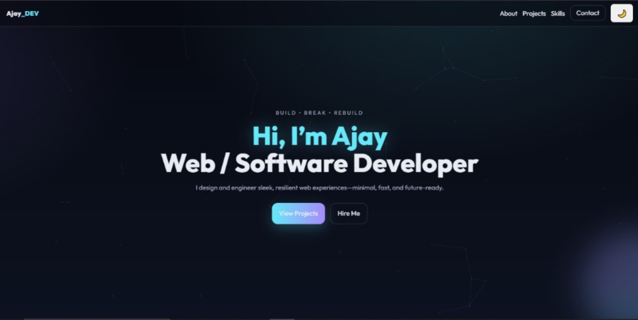
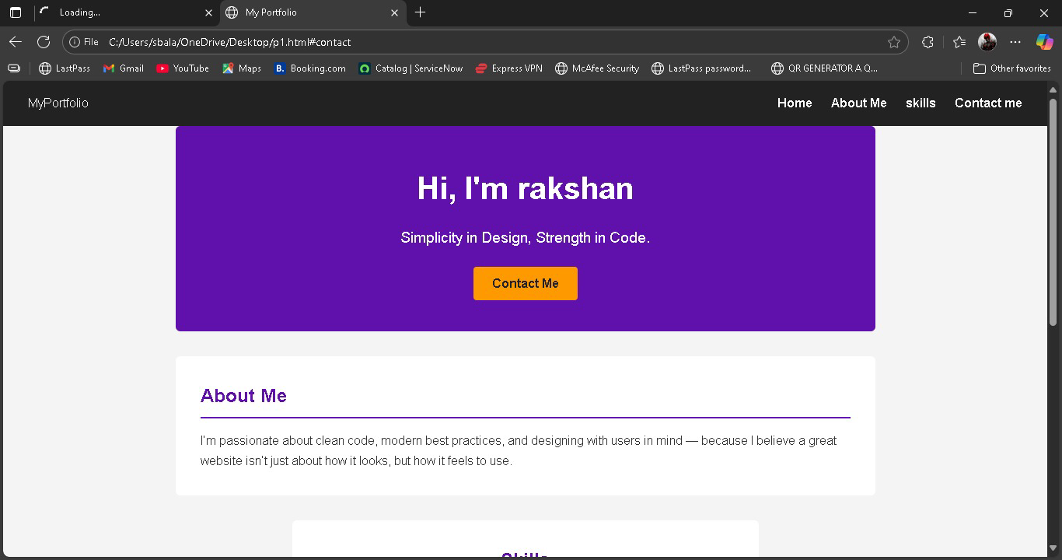

RESULTS AND SCREENSHOTS
3/21/2024 Annual Review

Slide 11
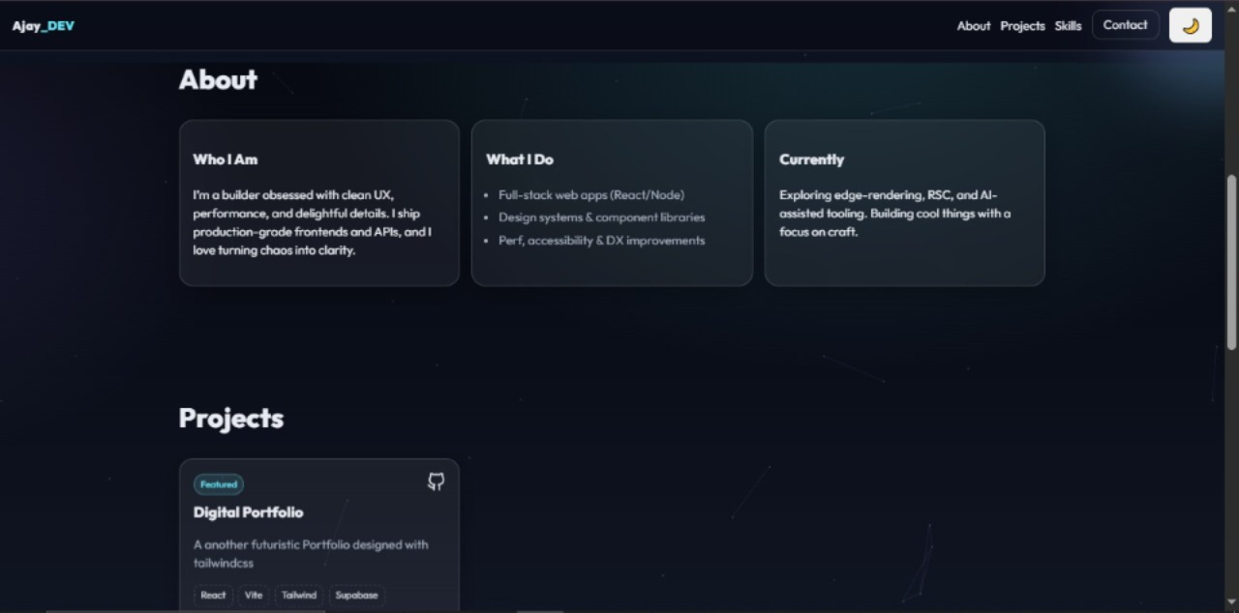
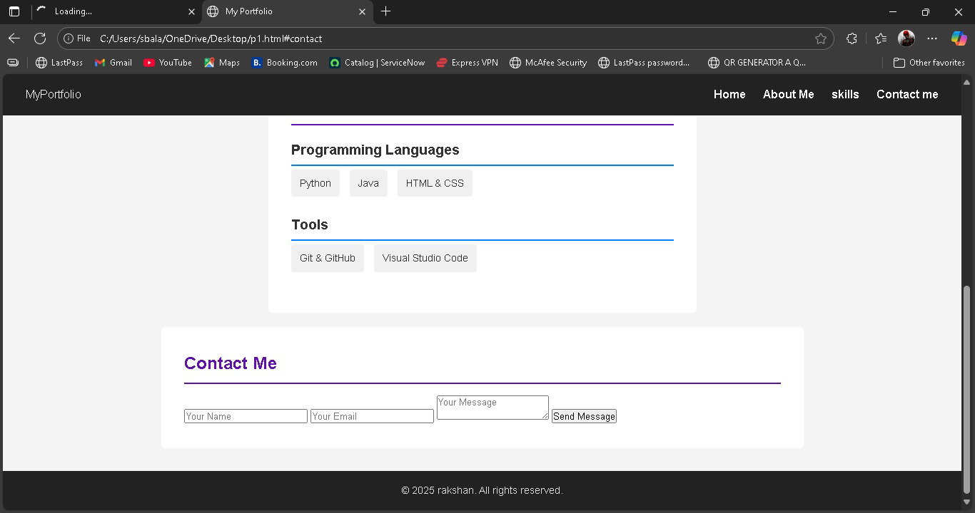

Slide 12
CONCLUSION
A digital portfolio is more than just a resume — it’s a creative way to showcase who I am, what I can do, and the work I’m proud of. It helps me stand out, connect with opportunities, and grow in today’s digital world.

Slide 13
GITHUB LINK
https://13657cs2024-spec.github.io/TNSDC-FWD-DP/

